Slide 1
Unit 4
Database Transactions and Query Processing

Slide 2
Basic concept of a Transaction
A transaction is a unit of work that is performed against a database.
Transactions are units or sequences of work accomplished in a logical order, whether in a manual fashion by a user or automatically by some sort of a database program.
A transaction is the propagation of one or more changes to the database
Eg update or delete on table
It is important to control these transactions to ensure the data integrity and to handle database errors.

Slide 3
Transaction Concept
A transaction is a unit of program execution that accesses and possibly updates various data items.
E.g. transaction to transfer $50 from account A to account B:
1. read(A)
2. A := A – 50
3. write(A)
4. read(B)
5. B := B + 50
6. write(B)
Two main issues to deal with:
Failures of various kinds, such as hardware failures and system crashes
Concurrent execution of multiple transactions

Slide 4
Example of Fund Transfer
Transaction to transfer $50 from account A to account B:
1. read(A)
2. A := A – 50
3. write(A)
4. read(B)
5. B := B + 50
6. write(B)
Atomicity requirement
if the transaction fails after step 3 and before step 6, money will be “lost” leading to an inconsistent database state
Failure could be due to software or hardware
the system should ensure that updates of a partially executed transaction are not reflected in the database
Durability requirement — once the user has been notified that the transaction has completed (i.e., the transfer of the $50 has taken place), the updates to the database by the transaction must persist even if there are software or hardware failures.

Slide 5
Example of Fund Transfer (Cont.)
Transaction to transfer $50 from account A to account B:
1. read(A)
2. A := A – 50
3. write(A)
4. read(B)
5. B := B + 50
6. write(B)
Consistency requirement in above example:
the sum of A and B is unchanged by the execution of the transaction
During transaction execution the database may be temporarily inconsistent.
When the transaction completes successfully the database must be consistent
Erroneous transaction logic can lead to inconsistency

Slide 6
Example of Fund Transfer (Cont.)
Isolation requirement — if between steps 3 and 6, another transaction T2 is allowed to access the partially updated database, it will see an inconsistent database (the sum A + B will be less than it should be). T1 T2
1. read(A)
2. A := A – 50
3. write(A) read(A), read(B), print(A+B)
4. read(B)
5. B := B + 50
6. write(B
Isolation can be ensured trivially by running transactions serially
that is, one after the other.
However, executing multiple transactions concurrently has significant benefits we will see later.

Slide 7
Properties of Transactions: ACID.
Atomicity − ensures that all operations within the work unit are completed successfully. Otherwise, the transaction is aborted at the point of failure and all the previous operations are rolled back to their former state.
All tasks of a transaction are performed or none of them are. There are no partial transactions. For example, if a transaction starts updating 100 rows, but the system fails after 20 updates, then the database rolls back the changes to these 20 rows.

Slide 8
Consistency − ensures that the database properly changes states upon a successfully committed transaction.
The transaction takes the database from one consistent state to another consistent state.
For example, in a banking transaction that debits a savings account and credits a checking account, a failure must not cause the database to credit only one account, which would lead to inconsistent data.

Slide 9
Isolation − enables transactions to operate independently of and transparent to each other.
The effect of a transaction is not visible to other transactions until the transaction is committed. For example, one user updating the hr.employees table does not see the uncommitted changes to employees made concurrently by another user. Thus, it appears to users as if transactions are executing serially.
Durability − ensures that the result or effect of a committed transaction persists in case of a system failure. Changes made by committed transactions are permanent.

Slide 10
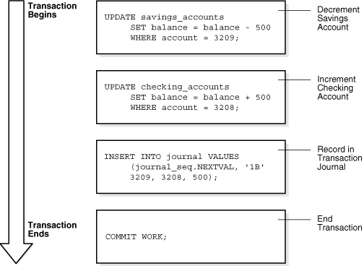

Slide 11
Transaction State
Active – the initial state; the transaction stays in this state while it is executing
Partially committed – after the final statement has been executed.
Failed -- after the discovery that normal execution can no longer proceed.
Aborted – after the transaction has been rolled back and the database restored to its state prior to the start of the transaction. Two options after it has been aborted:
restart the transaction
can be done only if no internal logical error
kill the transaction
Committed – after successful completion.

Slide 12
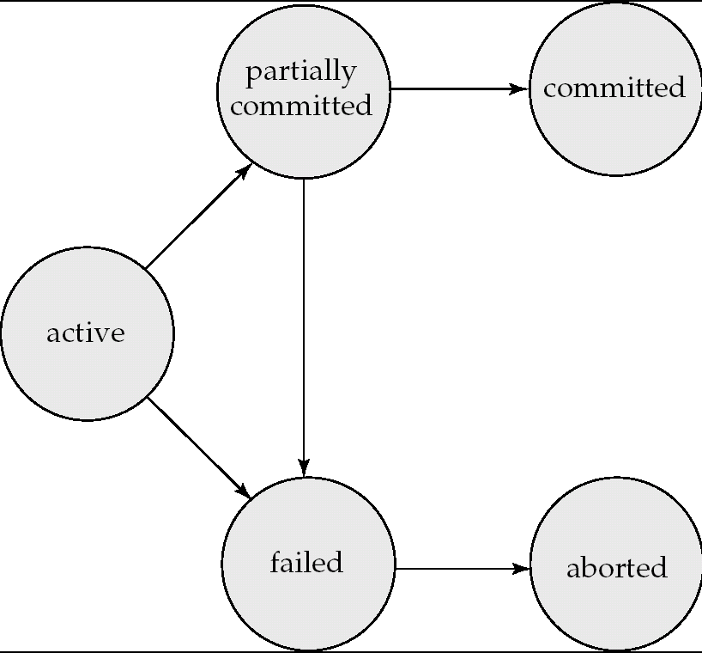
Transaction State (Cont.)

Slide 13
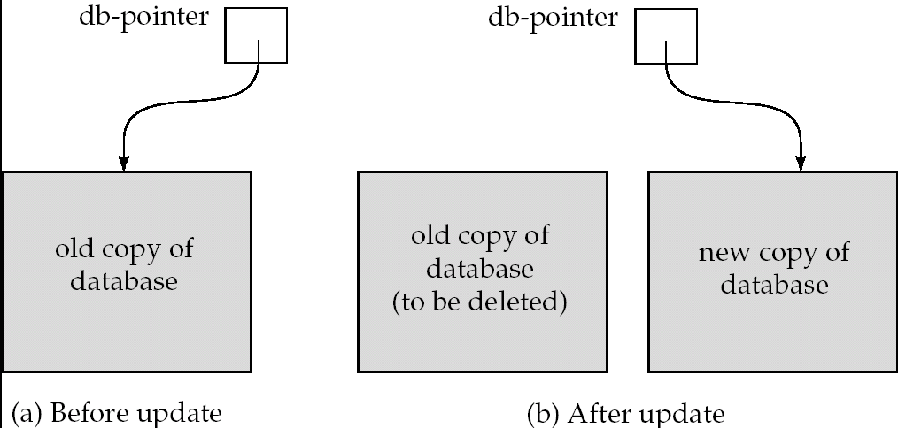
Implementation of Atomicity and Durability
The recovery-management component of a database system implements the support for atomicity and durability.
E.g. the shadow-database scheme:
all updates are made on a shadow copy of the database
db_pointer is made to point to the updated shadow copy after
the transaction reaches partial commit and
all updated pages have been flushed to disk.

Slide 14
Transaction Control
The following commands are used to control transactions.
Transactional control commands are only used with the DML Commands such as - INSERT, UPDATE and DELETE only. They cannot be used while creating tables or dropping them because these operations are automatically committed in the database.

Slide 15
COMMIT − to save the changes.
SQL> DELETE FROM CUSTOMERS WHERE AGE = 25;
SQL> COMMIT;

Slide 16
ROLLBACK − to roll back the changes. used to undo transactions that have not already been saved to the database. This command can only be used to undo transactions since the last COMMIT or ROLLBACK command was issued.
+----+----------+-----+-----------+----------+
| ID | NAME | AGE | ADDRESS | SALARY |
+----+----------+-----+-----------+----------+
| 1 | Ramesh | 32 | Ahmedabad | 2000.00 |
| 2 | Khilan | 25 | Delhi | 1500.00 |
| 3 | kaushik | 23 | Kota | 2000.00 |
| 4 | Chaitali | 25 | Mumbai | 6500.00 |
| 5 | Hardik | 27 | Bhopal | 8500.00 |
| 6 | Komal | 22 | MP | 4500.00 |
| 7 | Muffy | 24 | Indore | 10000.00 |
+----+----------+-----+-----------+----------+
SQL> DELETE FROM CUSTOMERS WHERE AGE = 25;
SQL> ROLLBACK;

Slide 17
A SAVEPOINT is a point in a transaction when you can roll the transaction back to a certain point without rolling back the entire transaction.
SAVEPOINT SAVEPOINT_NAME;
ROLLBACK TO SAVEPOINT_NAME;
SQL> SAVEPOINT SP1;
Savepoint created.
SQL> DELETE FROM CUSTOMERS WHERE ID=1;
1 row deleted.
SQL> SAVEPOINT SP2;
Savepoint created.
SQL> DELETE FROM CUSTOMERS WHERE ID=2;
1 row deleted.
SQL> SAVEPOINT SP3;
Savepoint created.
SQL> DELETE FROM CUSTOMERS WHERE ID=3;
1 row deleted.

Slide 18
SQL> ROLLBACK TO SP2;
Rollback complete.
SQL> SELECT * FROM CUSTOMERS;
+----+----------+-----+-----------+----------+
| ID | NAME | AGE | ADDRESS | SALARY |
+----+----------+-----+-----------+----------+
| 2 | Khilan | 25 | Delhi | 1500.00 |
| 3 | kaushik | 23 | Kota | 2000.00 |
| 4 | Chaitali | 25 | Mumbai | 6500.00 |
| 5 | Hardik | 27 | Bhopal | 8500.00 |
| 6 | Komal | 22 | MP | 4500.00 |
| 7 | Muffy | 24 | Indore | 10000.00 |
+----+----------+-----+-----------+----------+
6 rows selected.

Slide 19
The RELEASE SAVEPOINT command is used to remove a SAVEPOINT that you have created.
RELEASE SAVEPOINT SAVEPOINT_NAME;

Slide 20
The SET TRANSACTION Command
used to initiate a database transaction. used to specify characteristics for the transaction that follows.
For example, you can specify a transaction to be read only or read write.
The syntax for a SET TRANSACTION command is as follows.
SET TRANSACTION [ READ WRITE | READ ONLY ];

Slide 21
Concurrent Executions
Multiple transactions are allowed to run concurrently in the system. Advantages are:
increased processor and disk utilization, leading to better transaction throughput
E.g. one transaction can be using the CPU while another is reading from or writing to the disk
reduced average response time for transactions: short transactions need not wait behind long ones.
Concurrency control schemes – mechanisms to achieve isolation
that is, to control the interaction among the concurrent transactions in order to prevent them from destroying the consistency of the database

Slide 22
Schedules
Schedule – a sequences of instructions that specify the chronological order in which instructions of concurrent transactions are executed
a schedule for a set of transactions must consist of all instructions of those transactions
must preserve the order in which the instructions appear in each individual transaction.
A transaction that successfully completes its execution will have a commit instructions as the last statement
by default transaction assumed to execute commit instruction as its last step
A transaction that fails to successfully complete its execution will have an abort instruction as the last statement

Slide 23
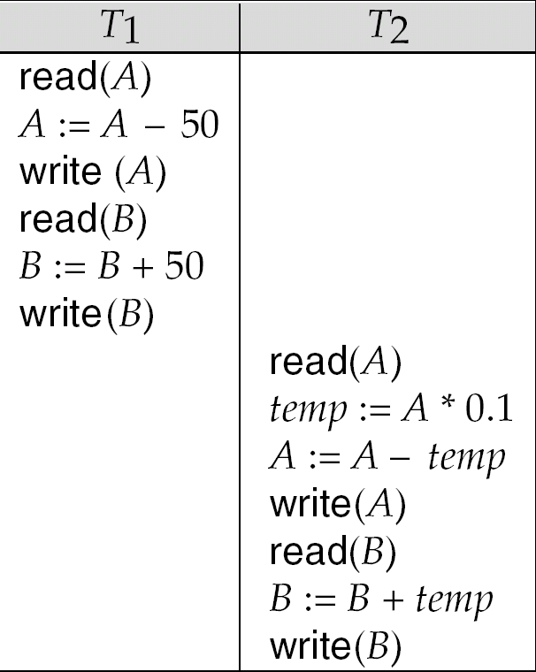
Schedule 1
Let T₁ transfer $50 from A to B, and T₂ transfer 10% of the balance from A to B.
A serial schedule in which T₁ is followed by T₂ :

Slide 24
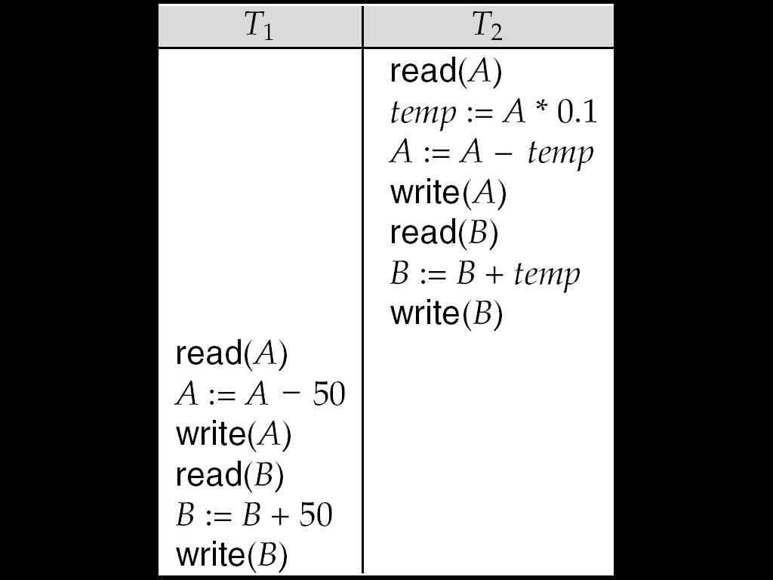
Schedule 2
A serial schedule where T₂ is followed by T₁

Slide 25
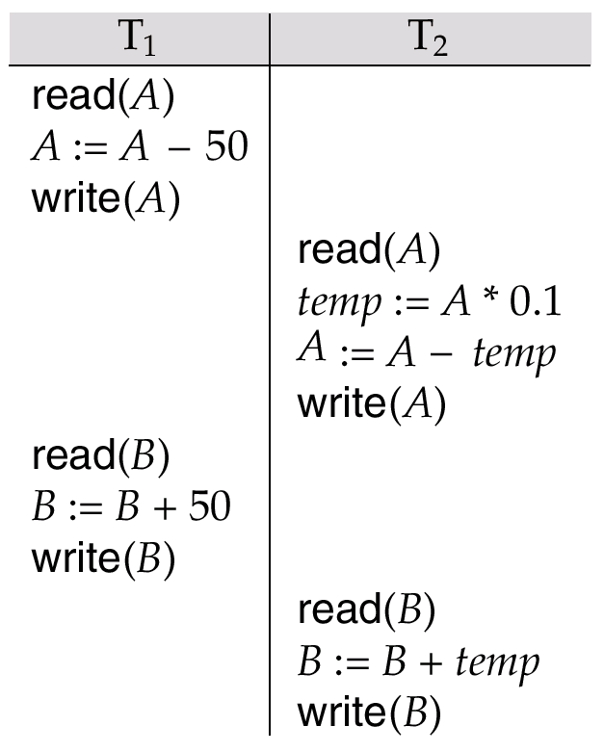
Schedule 3
Let T₁ and T₂ be the transactions defined previously.
The following schedule is not a serial schedule, but it is equivalent to Schedule 1.
In Schedules 1, 2 and 3, the sum A + B is preserved.

Slide 26
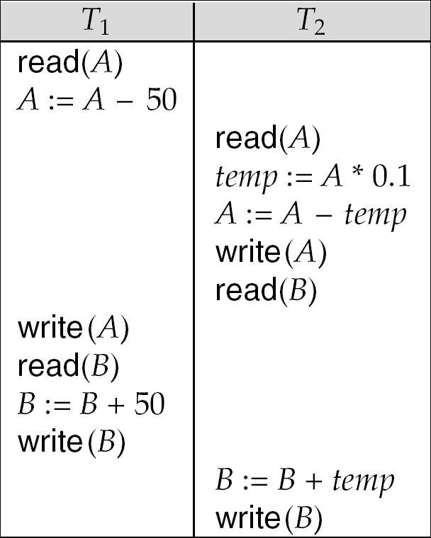
Schedule 4
The following concurrent schedule does not preserve the value of (A + B ).

Slide 27
Serializability
Basic Assumption – Each transaction preserves database consistency.
Thus serial execution of a set of transactions preserves database consistency.
A (possibly concurrent) schedule is serializable if it is equivalent to a serial schedule. Different forms of schedule equivalence give rise to the notions of:
1. conflict serializability
2. view serializability
Simplified view of transactions
We ignore operations other than read and write instructions
We assume that transactions may perform arbitrary computations on data in local buffers in between reads and writes.
Our simplified schedules consist of only read and write instructions.

Slide 28
Conflicting Instructions
Instructions l_{i} and l_{j} of transactions T_{i} and T_{j} respectively, conflict if and only if there exists some item Q accessed by both l_{i} and l_{j}, and at least one of these instructions wrote Q.
1. l_{i} = read(Q), l_{j} = read(Q). l_{i} and l_{j} don’t conflict. 2. l_{i} = read(Q), l_{j} = write(Q). They conflict. 3. l_{i} = write(Q), l_{j} = read(Q). They conflict 4. l_{i} = write(Q), l_{j} = write(Q). They conflict
Intuitively, a conflict between l_{i} and l_{j} forces a (logical) temporal order between them.
If l_{i} and l_{j} are consecutive in a schedule and they do not conflict, their results would remain the same even if they had been interchanged in the schedule.

Slide 29
Conflict Serializability
If a schedule S can be transformed into a schedule S´ by a series of swaps of non-conflicting instructions, we say that S and S´ are conflict equivalent.
We say that a schedule S is conflict serializable if it is conflict equivalent to a serial schedule

Slide 30
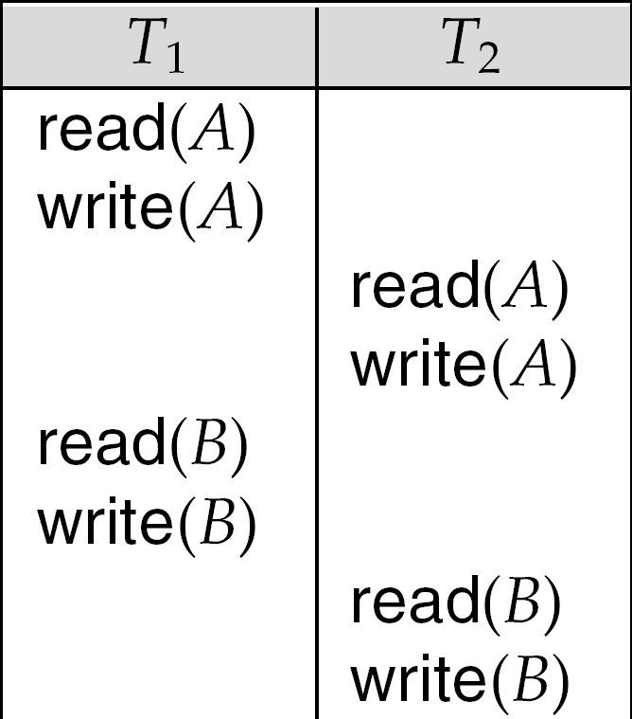
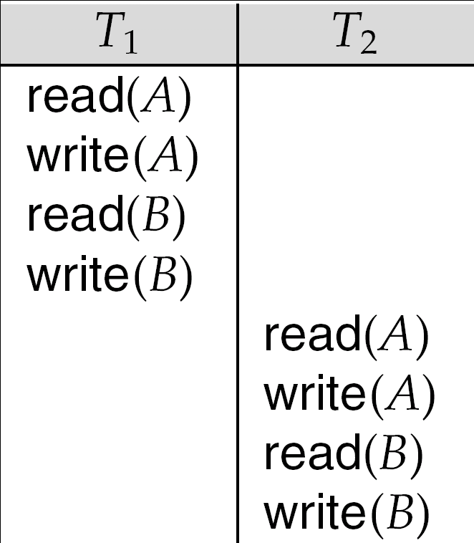
Conflict Serializability (Cont.)
Schedule 3 can be transformed into Schedule 6, a serial schedule where T₂ follows T₁, by series of swaps of non-conflicting instructions.
Therefore Schedule 3 is conflict serializable.
Schedule 3
Schedule 6

Slide 31
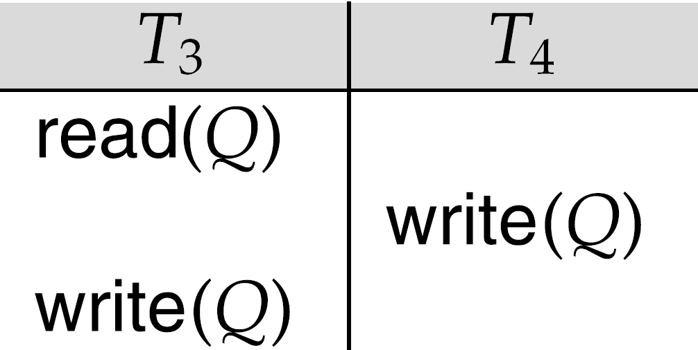
Conflict Serializability (Cont.)
Example of a schedule that is not conflict serializable:
We are unable to swap instructions in the above schedule to obtain either the serial schedule < T₃, T₄ >, or the serial schedule < T₄, T₃ >.

Slide 32
View Serializability
Let S and S´ be two schedules with the same set of transactions. S and S´ are view equivalent if the following three conditions are met, for each data item Q,
If in schedule S, transaction T_{i} reads the initial value of Q, then in schedule S’ also transaction T_{i} must read the initial value of Q.
If in schedule S transaction T_{i} executes read(Q), and that value was produced by transaction T_{j} (if any), then in schedule S’ also transaction T_{i} must read the value of Q that was produced by the same write(Q) operation of transaction T_{j} .
The transaction (if any) that performs the final write(Q) operation in schedule S must also perform the final write(Q) operation in schedule S’.
As can be seen, view equivalence is also based purely on reads and writes alone.

Slide 33
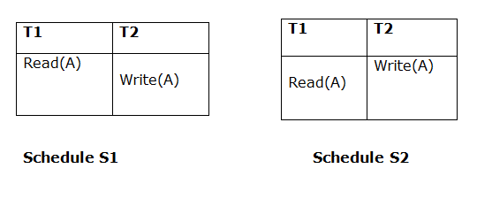
1. Initial Read
Above two schedules are view equivalent because Initial read operation in S1 is done by T1 and in S2 it is also done by T1.

Slide 34
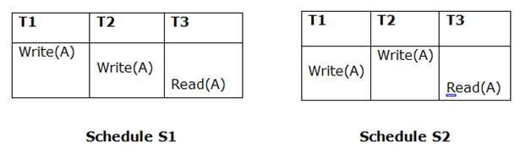
2. Updated Read
Above two schedules are not view equal because in S1, T3 is reading A updated by T2 and in S2, T3 is reading A updated by T1.

Slide 35
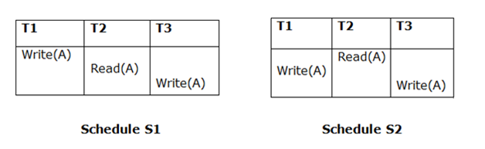
3. Final Write
Above two schedulesis view equal because Final write operation in S1 is done by T3 and in S2, final write operation is also done by T3.

Slide 36
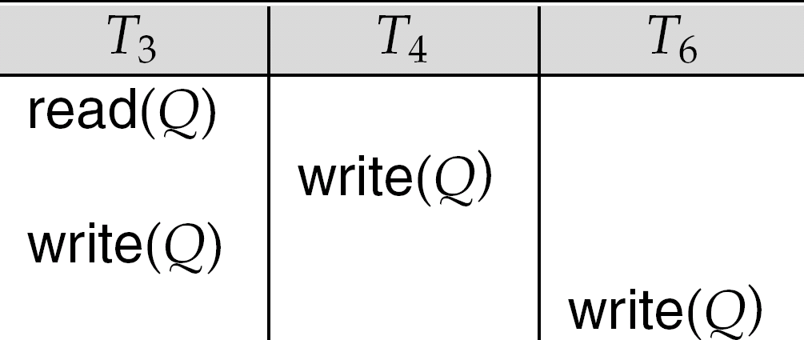
View Serializability (Cont.)
A schedule S is view serializable if it is view equivalent to a serial schedule.
Every conflict serializable schedule is also view serializable.
Below is a schedule which is view-serializable but not conflict serializable.
Every view serializable schedule that is not conflict serializable has blind writes.

Slide 37
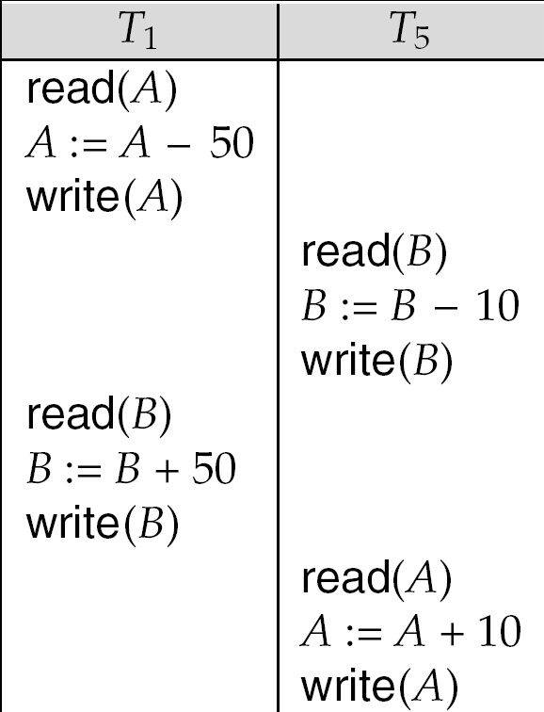
Other Notions of Serializability
The schedule below produces same outcome as the serial schedule < T₁, T₅ >, yet is not conflict equivalent or view equivalent to it.
Determining such equivalence requires analysis of operations other than read and write.

Slide 38
Recoverability of Schedule
Sometimes a transaction may not execute completely due to software issue, system crash or hardware failure.
In that case, the failed transaction has to be rollback. But some other transaction may also have used value produced by failed transaction. So we also have to rollback those transactions.

Slide 39
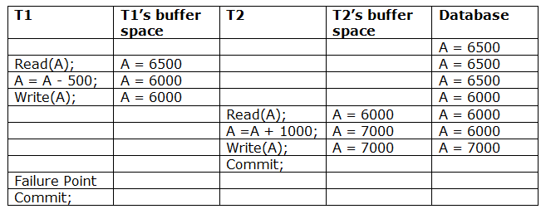
Irrecoverable schedule: The schedule will be irrecoverable if Tj reads updated value of Ti and Tj committed before commit of Ti.

Slide 40
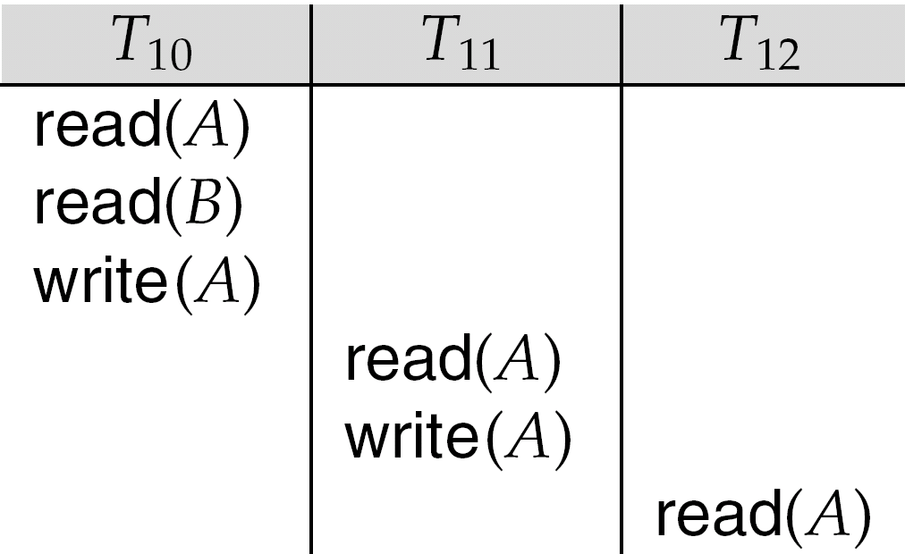
Cascading Rollbacks
Cascading rollback – a single transaction failure leads to a series of transaction rollbacks. Consider the following schedule where none of the transactions has yet committed (so the schedule is recoverable) If T₁₀ fails, T₁₁ and T₁₂ must also be rolled back.
Can lead to the undoing of a significant amount of work

Slide 41
Cascadeless Schedules
Cascadeless schedules — cascading rollbacks cannot occur; for each pair of transactions T_{i} and T_{j} such that T_{j} reads a data item previously written by T_{i}, the commit operation of T_{i} appears before the read operation of T_{j}.
Every cascadeless schedule is also recoverable
It is desirable to restrict the schedules to those that are cascadeless

Slide 42
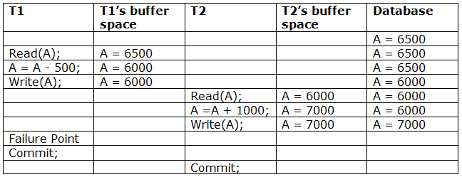
it has not committed before T1 commits so we can rollback transaction T2 as well. So it is recoverable with cascade rollback.
Recoverable with cascading rollback: The schedule will be recoverable with cascading rollback if Tj reads updated value of Ti. Commit of Tj is delayed till commit of Ti.

Slide 43
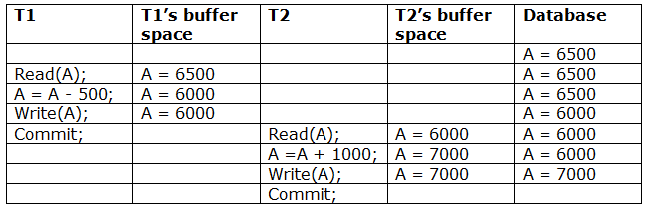
a schedule with two transactions. Transaction T1 reads and write A and commits and that value is read and written by T2. So this is a cascade less recoverable schedule.

